Slide 1
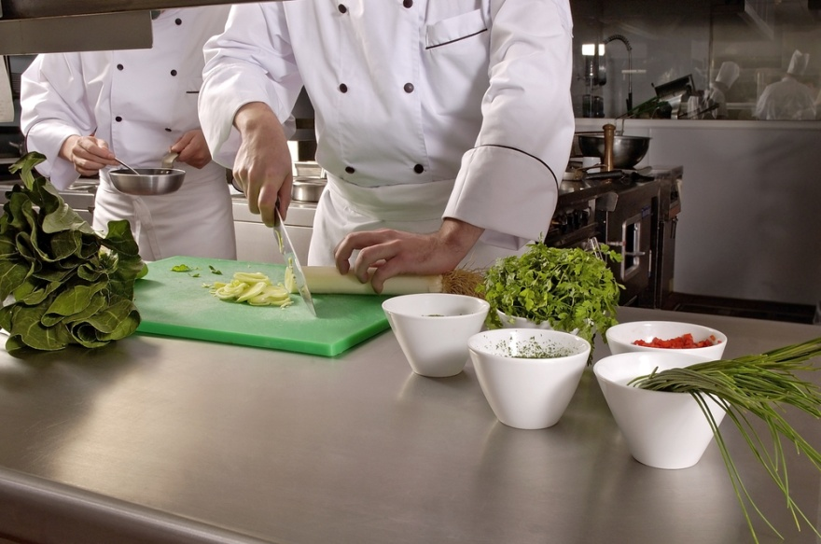
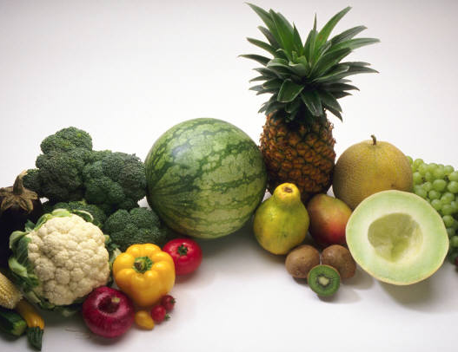
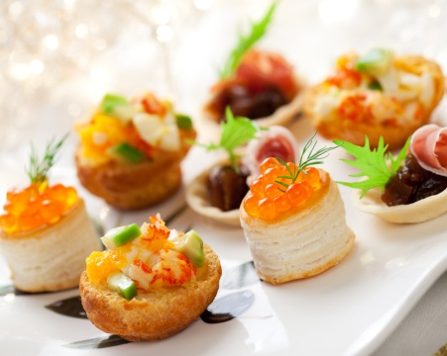
PLAN, PREPARE AND DISPLAY A BUFFET SERVICE
D1.HCC.CL2.07
Plan prepare display buffet service
Notes:
Welcome Students to the class

Slide 2

Plan, prepare and display a buffet service
Assessment for this Unit may include:
Oral questions
Written questions
Work projects
Workplace observation of practical skills
Practical exercises
Formal report from employer or supervisor
Notes:
Trainer to Advise:
Trainer advises students that assessment for this Unit may take several forms all of which are aimed at verifying they have achieved competency for the Unit as required.
Trainer indicates to students the methods of assessment that will be applied to them for this Unit.

Slide 3
Plan, prepare and display a buffet service
This unit comprises four elements:
1
Plan a buffet display and service
2
Prepare and produce buffet dishes
3
Display buffet dishes
4
Store Buffet items
Notes:
Trainer advises students this Unit comprises four elements, as listed on the slide explaining:
Each Element comprises a number of Performance Criteria which will be identified throughout the class and explained in detail
Students can obtain more detail from their Trainee Manual
The course presents advice and information but where their workplace requirements differ to what is presented, the workplace practices and standards must be observed.

Slide 4

Plan, prepare and display a buffet service
Element 1: Plan a buffet display and service
Plan a buffet display and service appropriate to client needs
Plan layout, display and presentation of the buffet
Calculate quantities required and food costs components of buffet
Select appropriate food items
Identify and prepare a variety of buffet centre pieces
Notes:
Trainer to advise:
Trainer to relate performance criteria to element 1
Performance criteria is the process by which the students training match the learning element
The element is the skill
To assess competency in the skill; the performance criteria is used to outline activities that can be used to assess competency.
The trainer should relate how the performance criteria is related to the element
To be able to Plan, prepare and display a buffet service the students must be able to; Plan a buffet display and service appropriate to client needs
The student should be able to do
Plan a buffet display and service appropriate to client needs
Plan layout, display and presentation of the buffet
Calculate quantities required and food costs components of buffet
Select appropriate food items
Identify and prepare a variety of buffet centre pieces

Slide 5
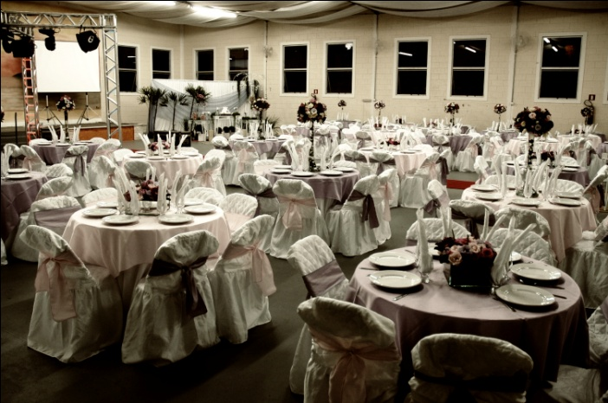
Plan, prepare and display a buffet service
Plan a buffet display and service as client requires
Theme:
Wedding
Birthday
National holiday
Religious celebration
School Reunion
Notes:
Trainer to advise:
What does the client want?
What can you supply? Answer: Your establishment can meet all clients requests. Really?
Do not take on what you cannot manage or learn to manage what ever comes along. Grow the business.
Expand the business
Before agreeing to client requests be sure you can deliver or direct them to business that you think can.
By doing this you gain the respect of the client and they may come back to you with something else later on as you are seen as honest in your own abilities and give good customer service
Student Activity:
Start developing portfolio of different ideas for theme functions
Work with front of house students and develop lists of what will be required to deliver satisfactory function to four different theme buffet

Slide 6
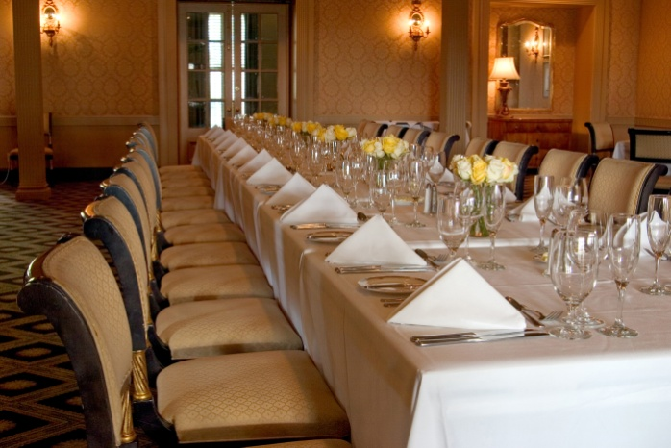
Plan, prepare and display a buffet service
Plan layout, display and presentation of the buffet
What are the customer requirements?
Where will it be held?
What facilities will be available?
Notes:
Trainer to advise:
Where will the function be delivered or held
What facilities are available
Inside
Outside
Offsite
Many things need to be considered when deciding to do the buffet.
Skill of the staff can be considered to be competent if the items are placed onto the menus

Slide 7

Plan, prepare and display a buffet service
Calculate quantities required and food costs for buffet
Types of food required
Number of people
Portion size allowed
Notes:
Trainer to advise:
Food cost is related to the requirement of the customer
If they require top quality seafood and the finest most tender meat then the cost will be high.
How many people will be attending?
The more people then this allows for some better quality foods to be offered as the number served off-sets the work required.
It is difficult to serve food that takes a lot of preparation time and cooking time in small numbers
It takes the same time to produce 12 chocolate cakes as it does to produce 1, relatively.
Also portion size for buffet is smaller and larger numbers can be served from standard recipes

Slide 8

Plan, prepare and display a buffet service
Select appropriate food items
Buffet food items will include a wide variety of menu items from which to choose:
Budget pricing
Moderate pricing
Top quality pricing
Notes:
Trainer to advise:
The different pricing of the menus will be related to the price per head that the customer is prepared to pay.
The food cost can be separate to the venue cost.
Venue management should have all this in their package that is presented to the client

Slide 9
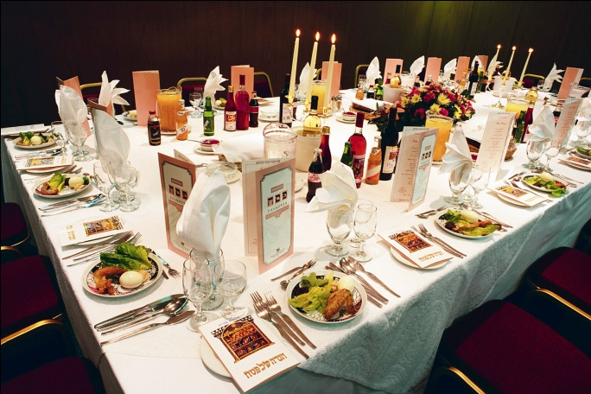
Plan, prepare and display a buffet service
Select appropriate food items
Buffet food items will include a wide variety of menu items from which to choose:
Children's party
Teenager’s party
Business function
Wedding anniversary
Notes:
Trainer to advise:
Food will have to be different for each of the groups
Children’s food will be different to teenagers food
Teenager food will be more sophisticated than children’s food but more casual than business function or buffet
Wedding or wedding anniversary food will be slightly different

Slide 10
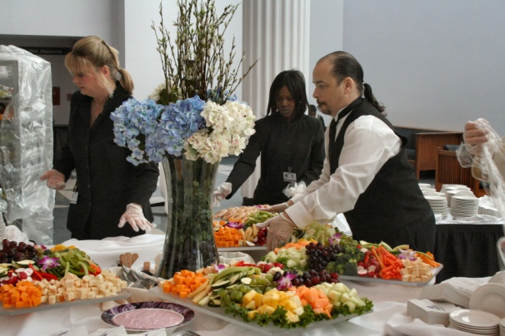
Plan, prepare and display a buffet service
Select appropriate food items
Buffet food items will include a wide variety of menu items from which to choose:
Vegetarians
Special dietary needs:
Gluten free
Nut allergies
Seafood and fish allergies
Notes:
Trainer to advise:
Special consideration might be made for Special Dietary requirements
If it is a religious festival and no meat is eaten by followers of this religion then meat dishes will be off the menu
Even for people who may not particularly follow the specific religious lifestyles it would be bad manners not to respect beliefs and practice that guide that religious lifestyle
Medical dietary limitation
Australian Food laws have changed significantly in the last ten years.
Food allergens are now required to be listed on labels and menus
Keeping the customer informed makes it easier for them to make an informed choice rather than asking all the relevant questions they may need to ask when ordering food from restaurants.

Slide 11

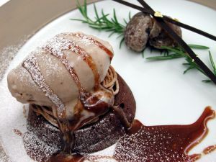
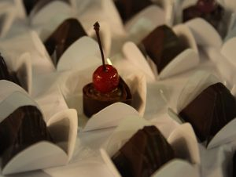
Plan, prepare and display a buffet service
Identify and prepare a variety of Centre pieces
Theme:
Chocolate
Sugar work
Ice carvings
Flowers
Notes:
Trainer to advise:
There may be a major theme for the buffet
How many different mediums can be utilised in the buffet display
Chocolate can be used on the entremets and pastry table
Sugar can be used for the major theme display
Table decorations that are sturdy and strong can use sugar; remember, they will pick at it and it will break if too fine.
Ice can be utilised for the seafood display; be sure to have drainage for melting ice
Flowers in season or imported if the client wishes to meet extra cost can be used all over

Slide 12

Plan, prepare and display a buffet service
Need for artistic skills
Regardless of who is in charge of designing or setting up centrepieces or decorations it is essential that the person has suitable artistic skills to ensure the decoration:
What artistic skills do staff need?
How can they get these skills?
Notes:
Trainer to discuss questions in the slide.

Slide 13

Plan, prepare and display a buffet service
Need for artistic skills
Considerations:
Reflects the theme
Is suitable
Is made up of correct materials and colours
Is correctly placed and sized
Does not impact on the quality of food items
Remains in suitable condition or quality during the life of the buffet
Notes:
Trainer to advise:
How can they ensure what they are setting up is correct?

Slide 14
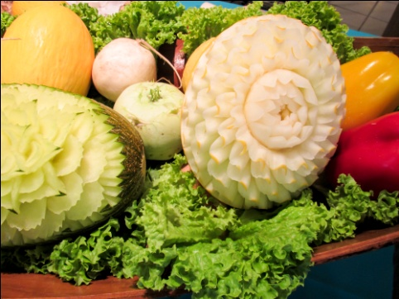
Plan, prepare and display a buffet service
Element 2: Prepare and produce buffet dishes
Select appropriate preparation and cooking methods for dishes on buffet menu
Glaze buffet foods were appropriate
Hold prepared products as required prior to presenting
Prepare garnishes, sauces and accompaniments for appropriate buffet dishes
Use trimming and leftovers
Notes:
Trainer to advise:
Trainer to relate performance criteria to element 2
Performance criteria is the process by which the students training match the learning element
The element is the skill
To assess competency in the skill; the performance criteria is used to outline activities that can be used to assess competency.
The trainer should relate how the performance criteria is related to the element
To be able to Plan, prepare and display a buffet service the students must be able to; Prepare and produce buffet dishes
The student should be able to do
Select appropriate preparation and cooking methods for dishes on buffet menu
Glaze buffet foods were appropriate
Hold prepared products as required prior to presenting
Prepare garnishes, sauces and accompaniments for appropriate buffet dishes
Use trimming and leftovers

Slide 15
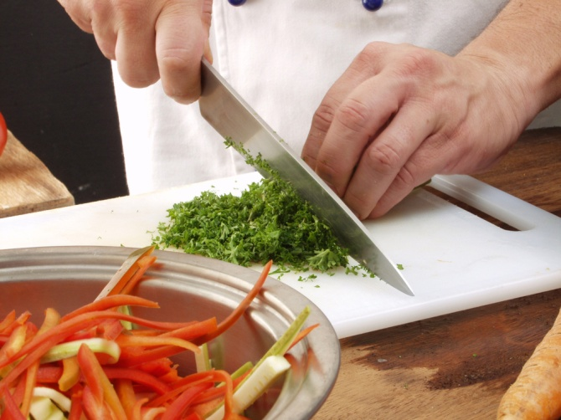
Plan, prepare and display a buffet service
Select cooking methods for buffet dishes
Preparation prior
Cooking on the day
Serving? Ease of
Serving? Speed of
Notes:
Trainer to advise:
Buffet will have many methods of cooking when using a wide range dishes
What can be prepared before the buffet 85%
What will be cooked on the day of the buffet 10%
What will be cooked to order during the buffet to order 5%

Slide 16
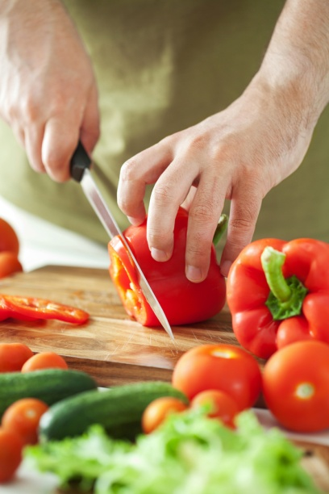
Plan, prepare and display a buffet service
Glaze buffet foods
Eye appeal:
Decorate with colour cut outs
Theme:
Decoration on glazed
Ease of service:
Lay one piece flat showing internal detail:
Highlights the skill of the cook and entices customer to select
Notes:
Trainer to advise:
Glazing of buffet food has two roles
To add eye appeal to the food
To protect the food from drying and looking ‘OLD’
Decorate a whole fish
The fish is cooked and going to be served whole
The colour can look dreary, grey and dull as they skin dries
It can be covered with clear ASPIC but the colour is still grey
Chaud froid is a aspic and veloute mixture that is applied to outside of cooked cold food
When it has set it leaves a blank canvas to be decorated
Decoration must be edible
Coloured vegetable portions or coloured jelly cut into different shape with aspic cutters
Clear aspic jelly
Is normally applied to food that needs to be protected from drying but still able to show attributes of food underneath
Slices of terrine or Galantine showing many layers but still protecting the food from drying

Slide 17

Plan, prepare and display a buffet service
Hold prepared products
Storing after preparing and before serving:
Keep on separate containers
Available space:
Store in designated space
Correct temperature:
Keep all cooked food chilled until required
Notes:
Trainer to advise:
Preparing buffet foods normally requires advanced planning and preparation.
Foods can be cooked that are going to be served cold. Then have to be portioned or sliced.
These then have to be stored until required, normally overnight.
These have to be kept chilled
When food is prepared for specific buffet it all needs to be placed in separated space else it gets used by somebody else for their customers.

Slide 18
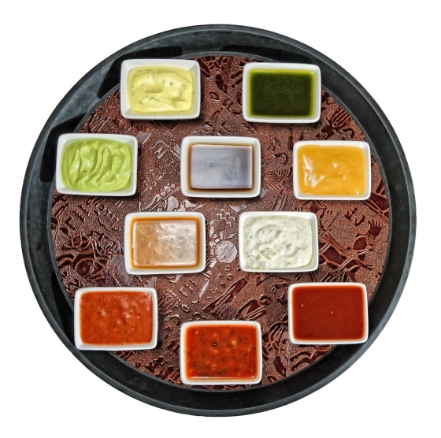
Plan, prepare and display a buffet service
Prepare garnishes and sauces
Variety:
Not all green chopped herb
Complimenting to food display:
Keep to the theme of buffet
Sauces:
Variety on side
Condiments to compliment
Notes:
Trainer to advise:
Garnishes needs to be prepared for most dishes.
The object is to add colour and interest to the food display
Buffet production requires a large variety of garnishes;
you cannot have chopped herb on everything else it all looks the same
Herbs
Julienne of coloured vegetables
Shaved hard cheese like parmesan
Pickled vegetables like olives
Deep fried onion or leeks
Flower petals
Slices of fruit
Baked pastry shapes
Sugared strips of citrus peel dried
Sauces
Have a selection for the one meat; allow customer to choose
Condiment served on side with easy access for customers to choose

Slide 19
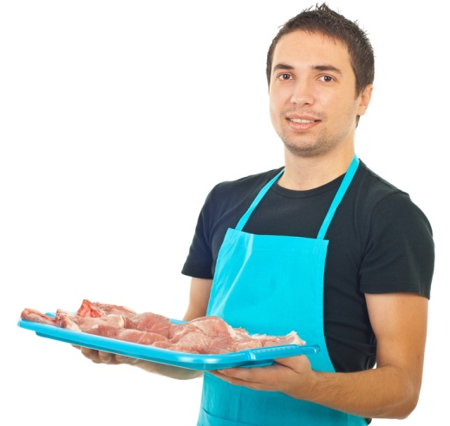
Plan, prepare and display a buffet service
Use trimmings and leftovers
Utilising valuable commodity:
Save left over commodity for future use in menus
Adding value:
Trimmings can be used in sauces and other dishes where applicable
Notes:
Trainer to advise:
Leftovers
All production in the kitchen generates trimmings and leftovers
Leftover cooked meats that have not left the kitchen can be can be vacuum packed and stored for another function
Left over prepared salads that have not left the kitchen and not been dressed can be used for another function or staff meals the following day
Trimmings:
Trimmings that have been generated from production can be utilised and value added in other dishes or sauces for future use.

Slide 20
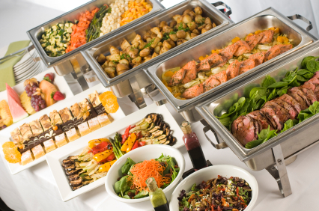
Plan, prepare and display a buffet service
Element 3: Display buffet dishes
Present buffet products
Hold prepared products as required for duration of buffet service
Minimise wastage through presentation and replenishing
Display buffet dishes attractively
Notes:
Trainer to advise:
Trainer to relate performance criteria to element 3
Performance criteria is the process by which the students training match the learning element
The element is the skill
To assess competency in the skill; the performance criteria is used to outline activities that can be used to assess competency.
The trainer should relate how the performance criteria is related to the element
To be able to Plan, prepare and display a buffet service the students must be able to; Display buffet dishes
The student should be able to do
Present buffet products
Hold prepared products as required for duration of buffet service
Minimise wastage through presentation and replenishing
Display buffet dishes attractively

Slide 21
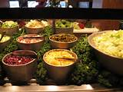
Display buffet dishes
Knowledge of staff setting up buffets
It is essential that staff, be it kitchen or service staff, involved in the set up of a buffet have enough knowledge to understand what needs to be set up:
What knowledge do staff need to know about an upcoming buffet?
Notes:
Trainer to advise:
Discuss the question in the slide

Slide 22
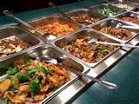
Display buffet dishes
Knowledge of staff setting up buffets
Policies and procedures for setting up buffets
How they should be set up
What menu items are to be served
How they are to be served
What crockery, cutlery or glassware is required
Notes:
Trainer to advise:
Discuss the options under each point.

Slide 23
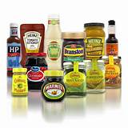
Display buffet dishes
Knowledge of staff setting up buffets
What service ware is required
What holding equipment is required
Decorations or accompaniments
Signs that are needed to identify food items
An understanding of the ingredients of menu items to ensure any customer enquiries can be answered accurately
Notes:
Trainer to advise:
Discuss the options under each point.

Slide 24
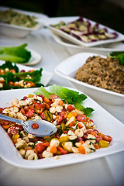
Display buffet dishes
Importance of professional table settings
The presentation of a buffet table says a lot to customers about the level of service they can expect to receive in an establishment.
A great deal of work and attention to detail must be applied when setting buffet tables:
What needs to be considered?
Notes:
Trainer to advise:
Discuss the question in the slide.

Slide 25
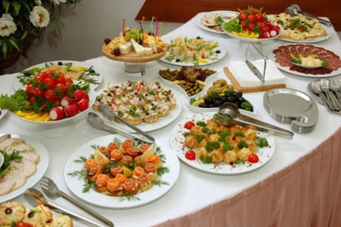
Display buffet dishes
Importance of professional table settings
Considerations
Have all the necessary service crockery, cutlery, centrepieces, decorations and condiments, to name but a few items
Must be complete
Must be clean and hygienic
Must be uniform and consistent throughout the outlet
Notes:
Trainer to advise:
Why is this important?
What else needs to be considered?

Slide 26
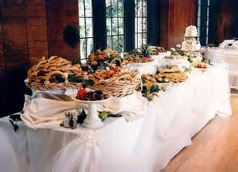
Display buffet dishes
Dressing tables
On special occasions, or as part of standard operating procedures, buffet tables may need to be dressed
Dressing takes place as part of the set up and enhances presentation of the table
It is time consuming, and frequently requires additional items to be used, so it is an uncommon activity, rather than a common one
Notes:
Trainer to discuss:
How can you dress a table?

Slide 27
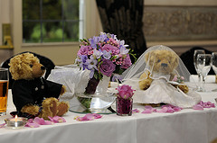
Display buffet dishes
Boxing tables
Tables can be boxed to enhance their appearance
It is usual to box buffet tables at functions
Boxing involves folding a table cloth around the vertical fall of the table so that the sides of the table and the legs are hidden from view
Notes:
Trainer to demonstrate:
How to box a table

Slide 28
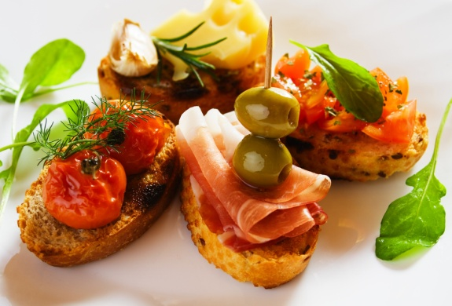
Display buffet dishes
Present buffet products
Shape of the platter:
Different shapes for different food add interest
Portion numbers on each platter:
Do not overload each platter
Colour:
Ensure garnishes are not same colour as food
Appealing to customer visual stimuli
Notes:
Trainer to advise:
Layout
When presenting buffet foods it is good to use different shape platters as well as different sizes
Keep cold foods separated from hot section

Slide 29
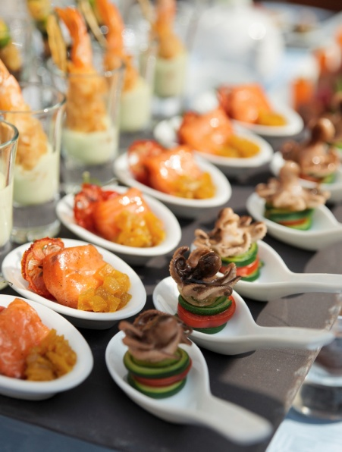
Display buffet dishes
Present buffet products
Shapes on the platter:
Different shapes of different food add interest
Entremets and pastries can be placed on same platter:
Square
Round
Different colour; red and yellow on same platter
Notes:
Trainer to advise:
Layout
By placing different small desserts, entremets, on same platter it allows for more even distribution around the room
Crème caramel.
Strawberry tartlets,
mini passionfruit vacherin;
chocolate mousse cups
All placed on same platter adds diversity and interest to display

Slide 30
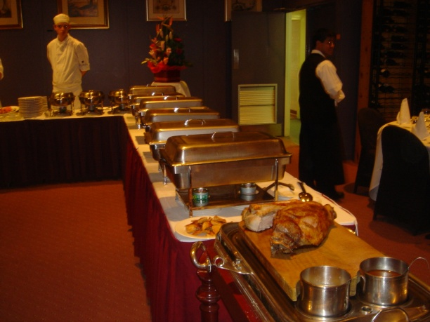
Plan, prepare and display a buffet service
Hold prepared products until required
Correct temperature
Time
Quality
Notes:
Trainer to advise:
When platters have been prepared they have to be stored until they are required.
Buffets are a lot of work; it cannot all be done at the same time.
Keep all hot foods above 60 degrees Celsius until ready to serve.
Timing of cooking and re-heating before service
Cold foods need to be kept in controlled atmosphere; below 5 degrees Celsius;
covered to protect from drying in open air; even in coolroom

Slide 31
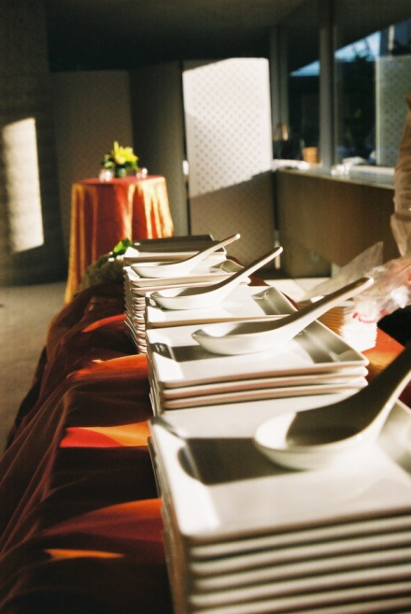
Plan, prepare and display a buffet service
Minimise wastage through presentation and replenishing
Size of platters used
Amount of food on platter
Time out of controlled atmosphere
Notes:
Trainer to advise:
Keeping platters smaller make for easier handling and also better control over how much food sits out on buffet table at once and for length of time it sits on function table
Keep amount of food on platters to manageable level
It may mean more work for staff or it may keep them occupied
It may mean more staff is required
Less food on platters means less time out of controlled temperature

Slide 32
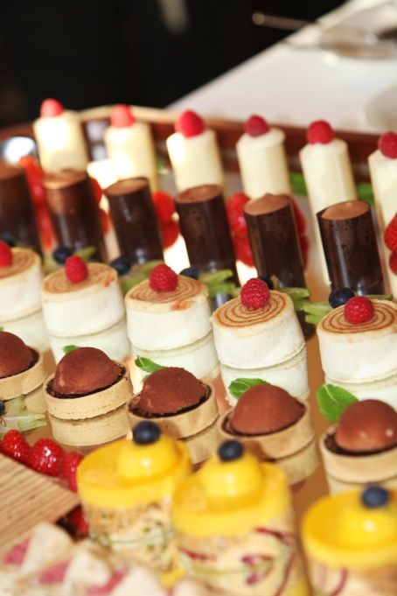
Plan, prepare and display a buffet service
Display buffet dishes attractively
Colour
Shape of platters
Distribution of food
Matching Centre piece displays
Notes:
Trainer to advise:
Use colour to make food appear more appealing
Different shapes help with display effect
How the food is distributed around the buffet
Try to match centre pieces to style of food
Ice carving of fish where the seafood is served or a pulled sugar stylized fish with seafood presentation.

Slide 33

Plan, prepare and display a buffet service
Element 4: Store buffet items
Store fresh and or vacuum packed items correctly
Store buffet products appropriately in correct containers
Label stored buffet food correctly
Store in correct conditions to maintain freshness and quality
Notes:
Trainer to advise:
Trainer to relate performance criteria to element 4
Performance criteria is the process by which the students training match the learning element
The element is the skill
To assess competency in the skill; the performance criteria is used to outline activities that can be used to assess competency.
The trainer should relate how the performance criteria is related to the element
To be able to Plan, prepare and display a buffet service the students must be able to; Plan a buffet display and service
The student should be able to do
Store fresh and/or Cryovac items correctly
Store buffet products appropriately in correct containers
Label stored buffet food correctly
Store in correct conditions to maintain freshness and quality

Slide 34
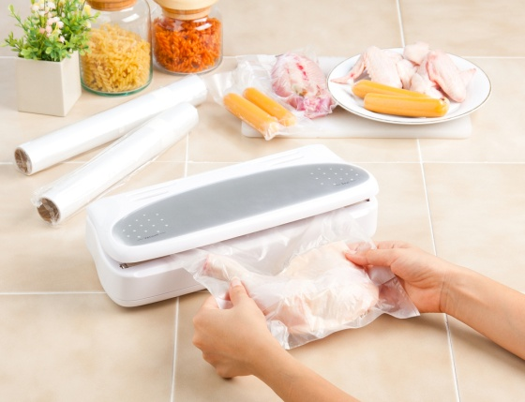
Plan, prepare and display a buffet service
Store fresh and vacuum sealed items correctly
Correct temperature
Length of storage
Layering
Notes:
Trainer to advise:
Correct storing of foods when receiving will help preserve until required
Ensure that stock is rotated out of storage
Do not order food too early unless u have proper storage facilities
When vacuum sealing foods be careful not to stack too many layers on top of each other.
It can damage shape of cooked foods

Slide 35
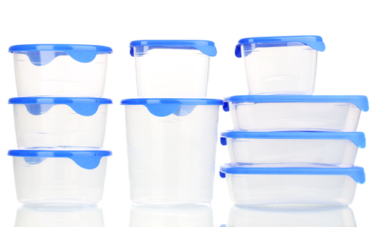
Plan, prepare and display a buffet service
Store buffet items in correct size containers
Correct type of containers
Food grade and undamaged
Size to match
Containers need to be large enough to hold securely
Notes:
Trainer to advise:
Ensure containers are of food standard
Containers that have had chemical inside cannot be used for food storage
Too large a container can damage product as it can move around too much

Slide 36

Plan, prepare and display a buffet service
Label stored buffet foods correctly
All the correct information:
Name of the product
Date of manufacture
Use by date
Name of person who made
Notes:
Trainer to advise:
Trainer to relate performance criteria to element 1

Slide 37
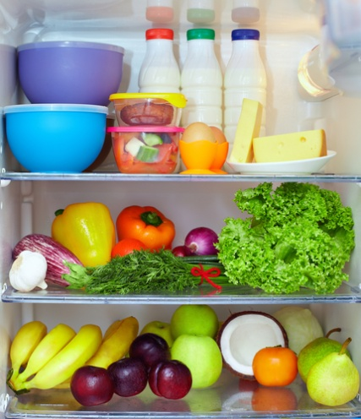
Plan, prepare and display a buffet service
Store in correct containers to maintain freshness and quality
Covering
Available space inside container
Notes:
Trainer to advise:
Do not overcrowd the containers
Ensure containers can be covered to protect the product

